Slide 1

February, 2026
Global Estimates of Tuberculosis Incidence During Pregnancy and Postpartum
Reviewer: Amin Muhammed Badawi
Authored by:
Mafirakureva, N., Cartledge, A., Bradshaw, I. et al. (2025)

Slide 2

BACKGROUND
TB caused approximately 1.25 million deaths globally in 2023
• Incidence peaks in women aged 15–49 years
• Pregnancy involves immunological modulation
• Pregnancy status rarely captured in TB registers
• No updated global estimate including postpartum or HIV stratification

Slide 3
STUDY OBJECTIVES
Estimate IRRs during pregnancy and postpartum
• Quantify global TB incidence rate ratio of TB during pregnancy and postpartum relative to non-pregnant periods.
• Stratify by age and HIV status

Slide 4
STUDY DESIGN
Stage 1: Rapid Review + Meta-analysis
Medline & EMBASE search
Observational studies with comparators
NIH quality assessment tool
Inverse-variance pooled IRRs
Stage 2: Mathematical Modelling
WHO TB data (2023)
UN fertility data
UNAIDS HIV prevalence data

Slide 5
MODELLING FRAMEWORK
Baseline TB incidence in women 15–49
Disaggregation by HIV status
Pregnancy duration: 9 months
Postpartum duration: 3 months
Apply IRRs to adjusted baseline
Assumed constant IRRs across regions

Slide 6
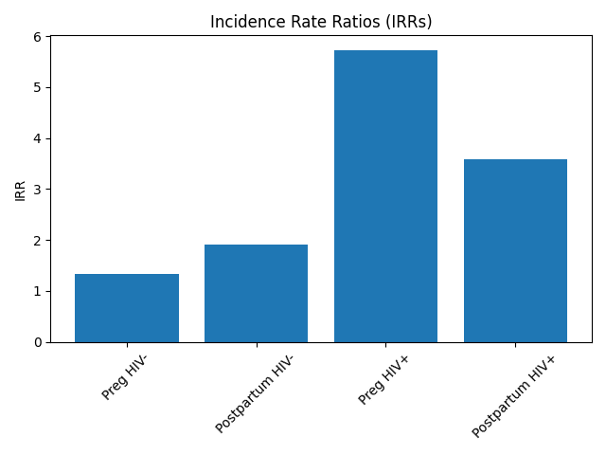
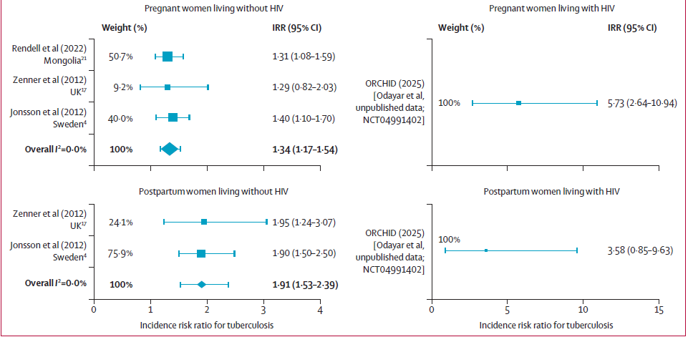
RESULTS: REALTIVE RISK
Incidence Rate Ratios (IRRs)
HIV-Negative Women:
Pregnancy IRR: 1.34 (1.10–1.54)
Postpartum IRR: 1.91 (1.53–2.39)
Women Living with HIV:
Pregnancy IRR: 5.73 (2.64–10.94)
Postpartum IRR: 3.58 (0.85–9.63)

Slide 7
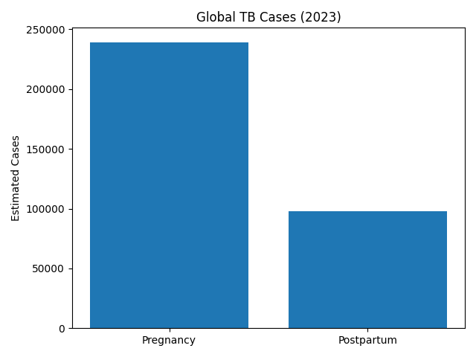
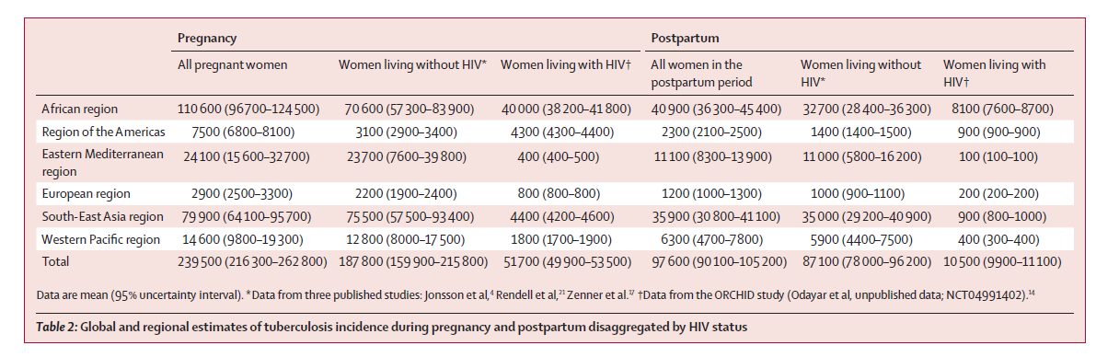
Results: Global Burden Estimates (2023)
Person-Time at Risk:
Pregnancy: 101 million person-years
Postpartum: 33 million person-years
Estimated Incident Cases:
• Pregnancy: 239,300 (216,100–262,100)
• Postpartum: 97,600 (90,000–105,200)
Total ≈ 336,900 cases annually

Slide 8
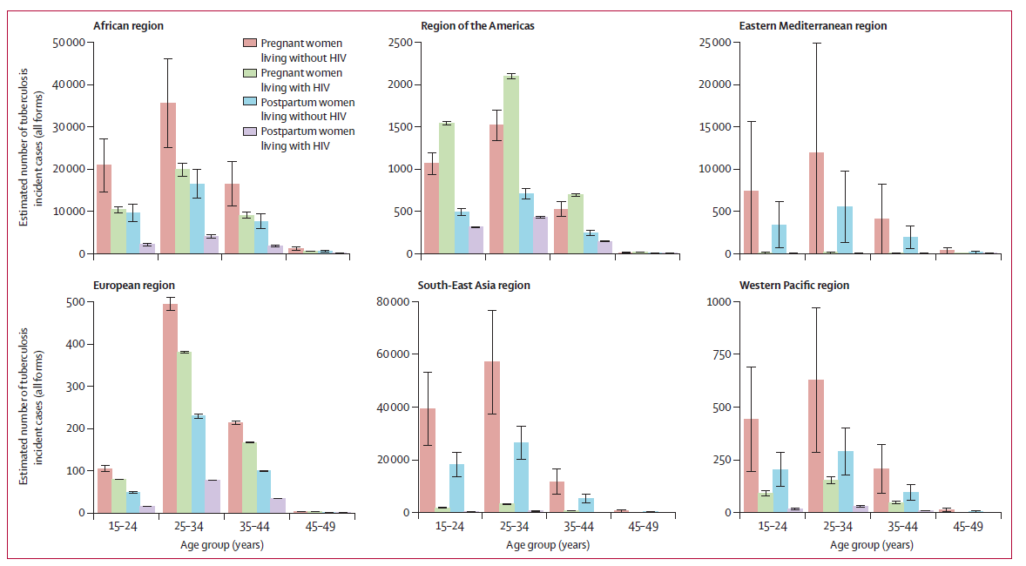
Results: Regional Distribution
Highest burden regions:
Southeast Asia: 115,900 (pregnancy), 51,800 (postpartum)
Africa: 115,500 (pregnancy), 42,700 (postpartum)
Most affected age group: 25–34 years

Slide 9
Results: HIV CONTRIBUTION
21% of pregnancy TB cases coinfected with HIV
11% of postpartum TB cases coinfected with HIV
~36% in African region among wLHIV
HIV acts as a major risk amplifier

Slide 10
Strengths and Limitations
Strengths:
First updated estimate in a decade
Includes postpartum period
HIV-stratified modelling
Limitations:
Limited number of IRR studies
European-dominated data
Uniform IRR assumption

Slide 11
SUMMARY & CONCLUSION
This study demonstrates that:
TB burden during pregnancy and postpartum is substantial
Postpartum risk, particularly among women living with HIV, is markedly elevated
Approximately 300,000 global TB cases annually occur in association with pregnancy
These findings underscore the necessity of integrating TB screening into maternal health services and improving postpartum surveillance.
Failure to address this intersection risks undermining both TB control and maternal health progress.
Thank you.

Slide 12
Floret Center for Advanced Genomics and Bioinformatics Research
📍 Lagos, Nigeria
📧 info@floretcenter.org
🌐 www.floretcenter.org

